Slide 1
Diagram

Slide 2

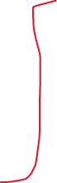

Diagram
Previous Block Hash
Previous Block Hash
Name of the Voter
Voter ID
Hash of the vote with SK
Name of the Voter
Voter ID
Hash of the Vote with SK
Final Hash of the Block
Final Hash of Block

Slide 3
This will take a good amount of time, based on how many voters are expected

